Slide 1
Anatomy of a web application
Section 10
Notes:
[Mandatory Slide] This would be the introduction slide of the topic that you are covering in this section.
When this slide plays, you could talk about the main aim that we’d be covering in this section.

Slide 2
What We’ll Learn
Introduction to web applications
Using MVC frameworks
Web applications fundamentals
Meet Flask and Django
The foundations of the WWW allow to build ubiquitous applicaitons
Frameworks make creating web applications easy and safe
Learn web app features and how they compares to desktop apps
The preminent Python web frameworks

Slide 3
Introduction to web applications
Notes:
[Mandatory Slide] This would be the introduction slide of the topic that you are covering in this subsection.
When this slide plays, you could talk about the main aim that we’d be covering in this video.

Slide 4
In this Video, we are going to take a look at…
What is a web application?
How client-server apps used to be before web applications
Examples of web applications
Notes:
[Mandatory Slide]
Before the start of the video, we’d like to highlight what are important topics or pointers that we’d be covering in this video. This slide would immediately follow the intro/name slide. This would just be say 2-3 points for the viewers to know what they are getting into.

Slide 5
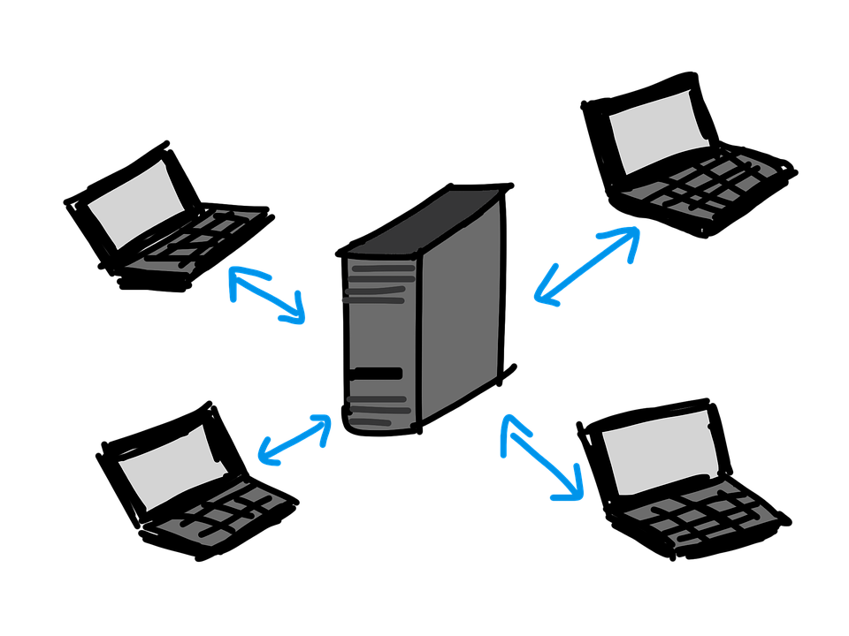

What is a web application?
First let’s define what a distributed application is: a computer program whose components run on different hosts and talk through a network using a communication protocol
A web application is a distributed application based on HTTP (and therefore on the client-server model) that is composed by two main parts: the client-side and the server-side
The client side of a web application always runs in a web browser and usually features standard web techs such as HTML, CSS and Javascript
Notes:
[Mandatory Slide]
Before the start of the video, we’d like to highlight what are important topics or pointers that we’d be covering in this video. This slide would immediately follow the intro/name slide. This would just be say 2-3 points for the viewers to know what they are getting into.

Slide 6
How client-server apps used to be before web applications
Client-server apps that are not based on HTTP need care:
No portability: clients needs to be manually installed/compiled on each supported platform
Need for updates: whenever updates to the servers happen, you need to re-install all clients
Firewall issues: you might need to adapt firewalls to open the protocol ports
No design uniformity and no standards enforcement because different protocols can be used
That’s OK for some very specific-purpose apps but not for mass-market applications
Notes:
[Mandatory Slide]
Before the start of the video, we’d like to highlight what are important topics or pointers that we’d be covering in this video. This slide would immediately follow the intro/name slide. This would just be say 2-3 points for the viewers to know what they are getting into.

Slide 7
Modern
web applications
Search engines (Google, Bing)
E-mail services (Gmail, Yahoo!)
Social Networks (Facebook, Twitter)
E-commerce (Amazon, Alibaba, Ebay)
Blogging Platforms (Tumblr, Medium)
Streaming Platforms (Spotify, Netflix)
…
A few examples
Almost any online service nowadays is a web application
Most of them also provide desktop clients for the major platforms and provide APIs as a backend data source

Slide 8
Summary
What is a web application?
How client-server apps used to be before web applications
Examples of web applications
Notes:
[Mandatory Slide]
Before the start of the video, we’d like to highlight what are important topics or pointers that we’d be covering in this video. This slide would immediately follow the intro/name slide. This would just be say 2-3 points for the viewers to know what they are getting into.

Slide 9
Web applications fundamentals
Next Video
Notes:
[Mandatory Slide]
Here the name of the next video needs to be mentioned. The narration as you guessed it would be just letting the viewer know exactly where we are at and what we’d be taking over next! ☺

